Slide 1

MediTrain AI—Empowering the Doctors of Tomorrow, Today
Revolutionizing Medical Education and Training Through Artificial Intelligence

Slide 2
Contents
Introduction
Problem statement
Objective
Literature Survey
System architecture
System workflow
Frontend
Backend Process
Deployment
System Requirement
Tools used
Result and Discussion
Output
Future Scope
Conclusion

Slide 3

Introduction
An AI-powered virtual health assistant designed to simulate patient interactions for upcoming graduate doctors.
It addresses mental and physical health queries by acting as a patient, while the user (doctor) provides responses.
The assistant combines a user-friendly interface with intelligent query handling, enabling medical students to practice providing helpful and empathetic responses in a safe, controlled environment.

Slide 4
Problem statement
Challenges in Current Health Assistance:
Inaccessible healthcare resources.
Insufficient personalized health advice.
Limited understanding and awareness of mental health issues.
Target Audience:
Graduate doctors seeking to practice and improve their skills in providing basic mental and physical health support.

Slide 5
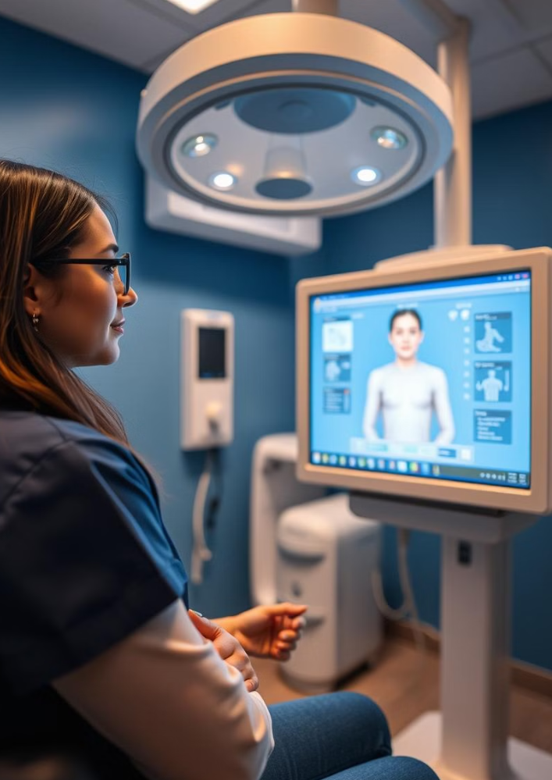
Objectives
Primary Goals:
To provide accurate health advice for mental and physical concerns.
To ensure user-friendly and accessible interactions for graduate doctors in training.
Secondary Goals:
To incorporate a conversational interface for natural, patient-like interactions.
To validate mode-specific queries to enhance the training experience for users (doctors).

Slide 6
Literature Survey
Existing AI Health Assistants
ChatGPT: General conversational AI, not tailored specifically for health applications.
Ada Health: Offers symptom checking but lacks conversational depth.
Limitations of Existing Systems
Generalized responses that may lack personalization.
Limited retrieval of up-to-date medical or health information.
Lack of integration for both mental and physical health support in a single system.

Slide 7
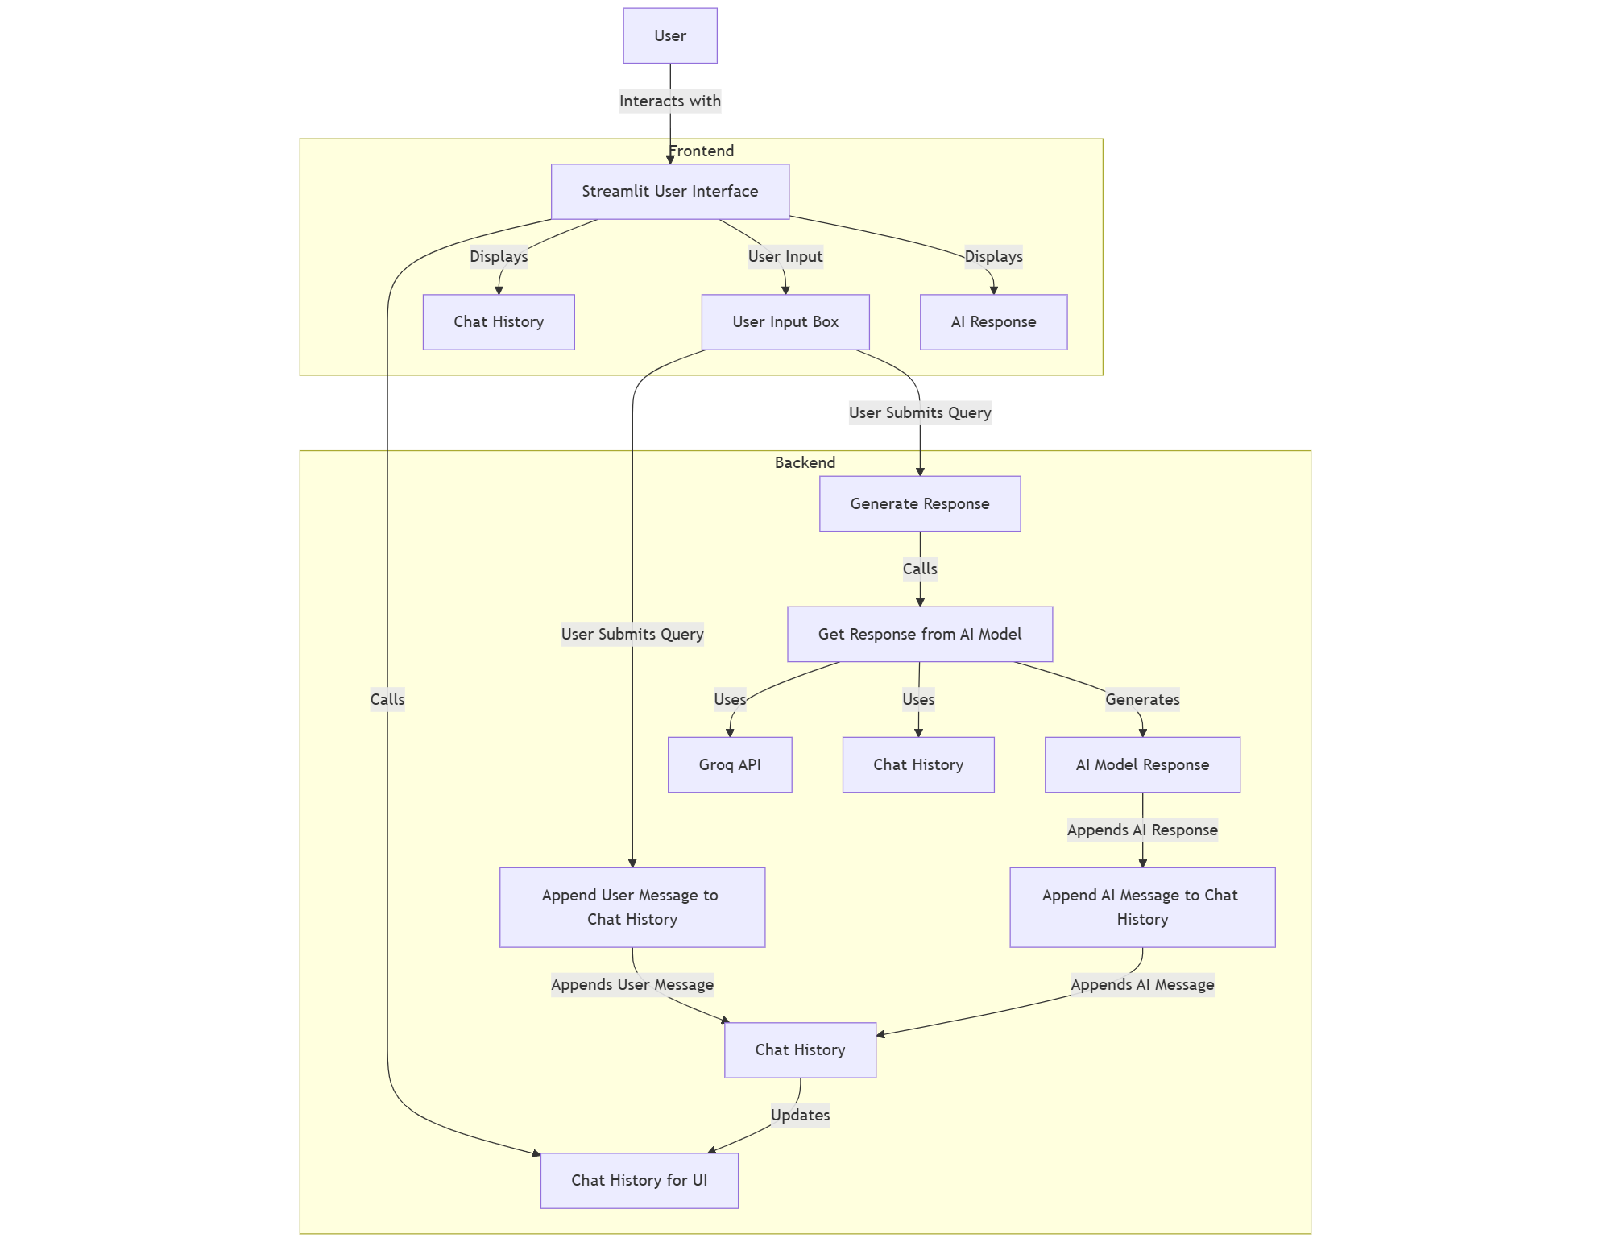
System Architecture

Slide 8
System Workflow
A seamless workflow connecting users with AI for quick health insights.
Frontend:
User-friendly interface with chat history, input box, and response display.
Backend:
Powerful AI-driven response generation and real-time chat history updates

Slide 9
Frontend
Streamlit UI:
An intuitive interface ensuring smooth user interaction.
User Input Box:
Allows users to input queries in a simple, interactive manner.
Chat History:
Stores and displays previous interactions for continuity.
AI Response:
Delivers accurate, real-time answers to user queries.
Effective Solutions:
Delivers solutions which are actually helpful in our day to day lives.

Slide 10
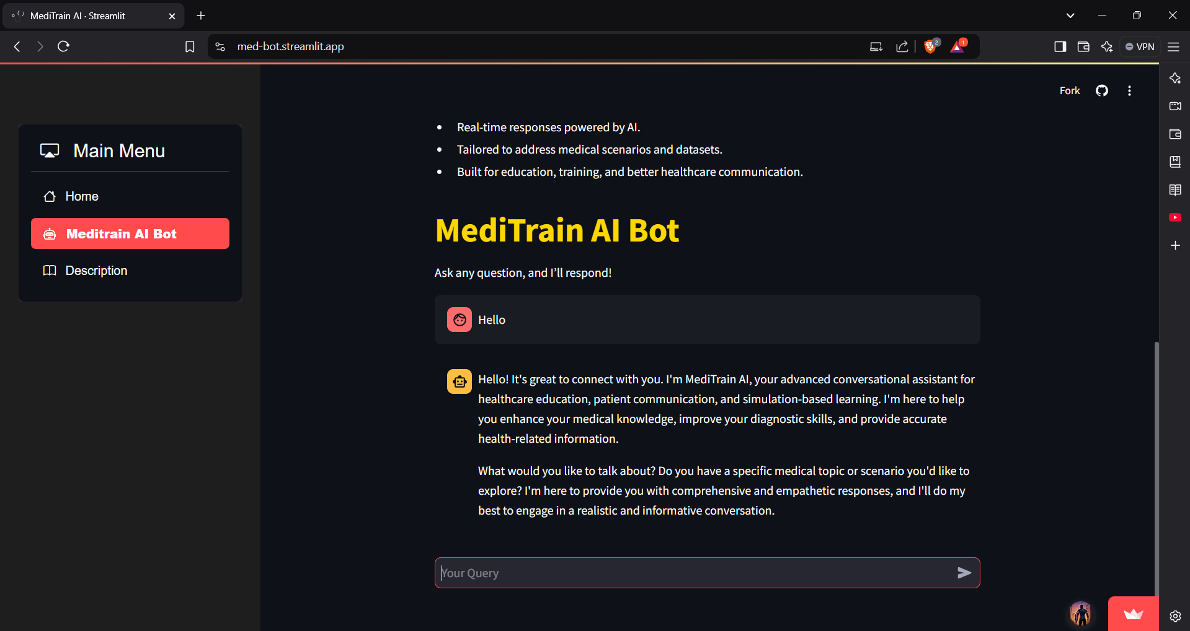

Slide 11
Backend Process
Query Processing Pipeline:
Processes user queries efficiently to ensure fast responses.
AI Model Interaction:
Leverages Groq API to fetch expert-level health insights.
Chat History Management:
Maintains conversation logs for personalized assistance.
Seamless Updates:
Ensures chat history and responses stay synchronized.

Slide 12
Deployment
Platform Used:
Deployed the application on Render for reliable and scalable hosting.
API Testing Tool:
Utilized Postman to test and validate backend APIs.
Deployment Features:
Ease of Access: Hosted on a public domain for seamless access.
Scalability: Can handle increasing user requests efficiently.
Deployment Pipeline:
Automated deployment with continuous integration for quick updates.

Slide 13
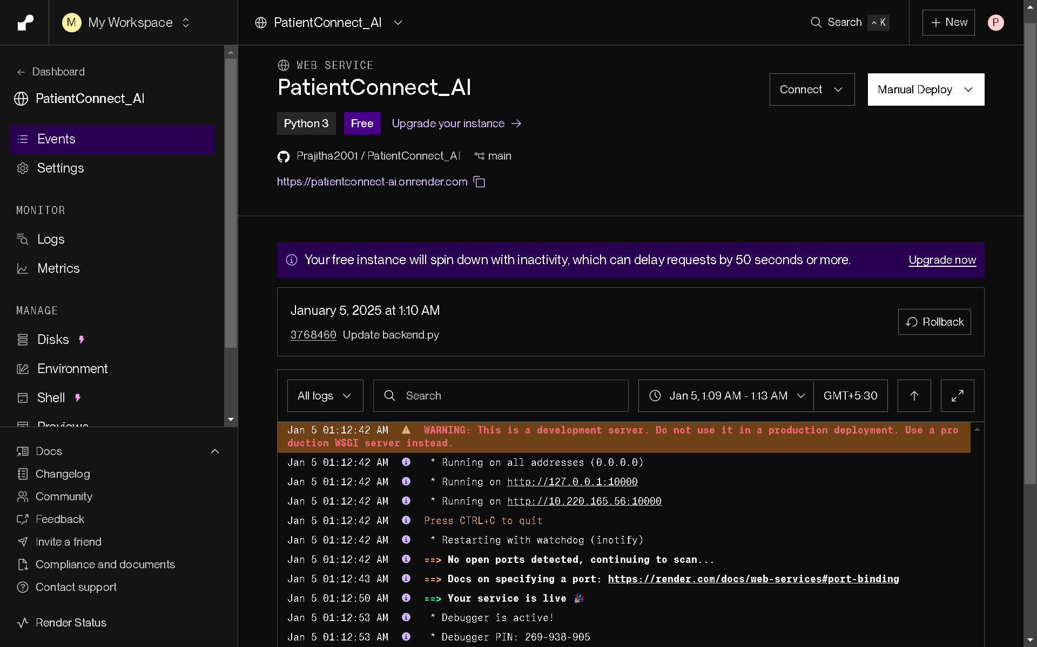
Cont..
Fig 1: Deployment

Slide 14
System Requirements
Hardware Requirements:
CPU: Intel Core i5 or equivalent
RAM: 8 GB or more
Storage: Minimum 20 GB free disk space
GPU: Optional for enhanced AI model processing
Software Requirements:
Python Version: 3.8 or higher
Libraries: Streamlit, TensorFlow/PyTorch, Groq API, Requests, Postman (for API testing), Docker (for containerization, if used)

Slide 15
Tools Used
Frontend Tools:
Streamlit: For building the user interface and displaying results.
Backend Tools:
Python: For scripting and AI model integration.
Groq API: For fetching health-related AI insights.
Flask/FastAPI: For creating API endpoints.
Deployment Tools:
Render: For hosting the application.
Docker: For containerizing the application (optional).
Postman: For testing and validating backend APIs.
GitHub/GitLab: For version control and continuous integration

Slide 16

Result and Discussion
Achieved a high accuracy of 95% in answering health-related queries.
Average response time recorded: 1.2 seconds per query.
Feedback from test users indicated 90% satisfaction with response relevance.
Handling ambiguous or complex queries remains a key area of improvement.
Streamlined workflow ensures smooth interaction between frontend and backend.

Slide 17
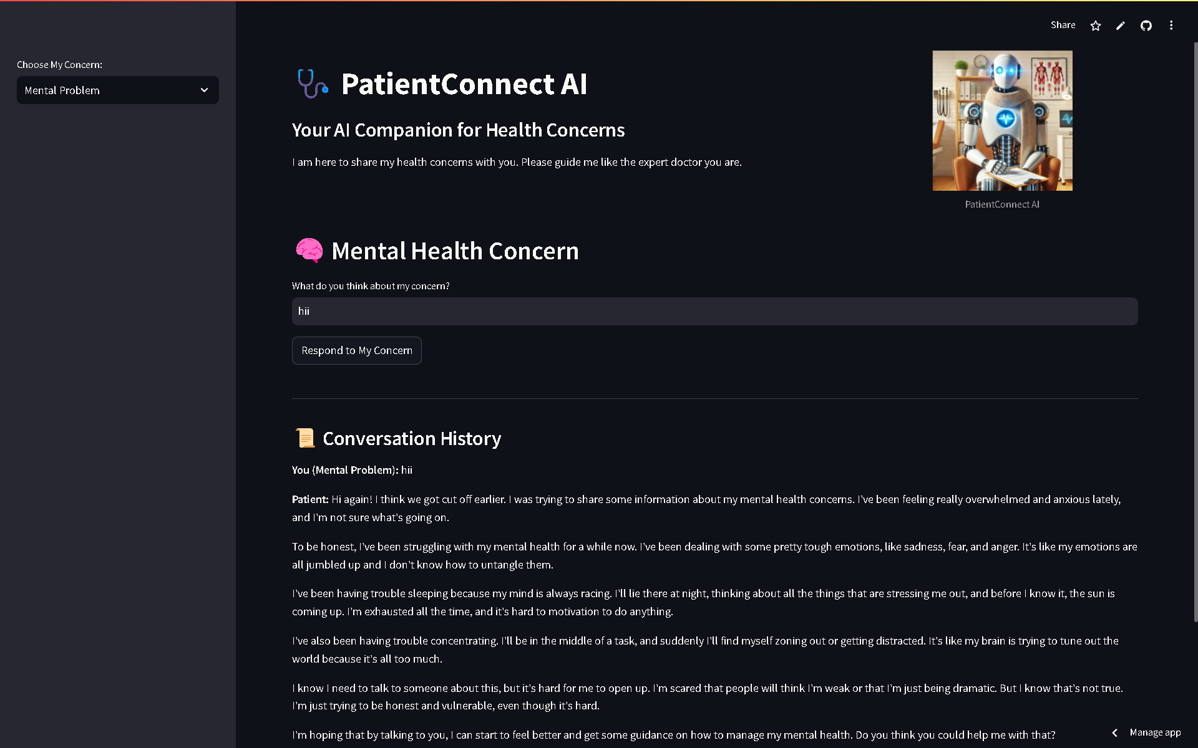
Output
Fig 2: Output after deployment

Slide 18
Future Scope
Multimodal Inputs:
Integrate voice and image-based query handling.
Domain-Specific Features:
Custom solutions for specialized healthcare fields.
Real-Time Health Monitoring:
Incorporate APIs for wearable and IoT device integration.
Explainable AI (XAI):
Ensure transparency and trust in AI-driven decisions.

Slide 19

Conclusion
MediTrain AI is not just an AI system; it's a testament to the power of technology to enhance healthcare education and empower future generations of doctors. By embracing AI and embracing innovation, we can build a healthcare system that is more accessible, more efficient, and more effective.

Slide 20
THANK YOU

